Slide 1
CENTRAL
PROCESSING
UNIT
Control
Logic
(CPU)
Computer Fundamentals and Ethics
CPU
Group Presentation
Group Members:
Speed
Rasel Chowdhury
Al Wahed Faisal Siman
3. Priyanta Boiddya
Uttshob Dey
Angkon Das
Memory
Cores
The “brain” that carries out computer instructions

Slide 2
Presentation Overview
Two slides per speaker — about one minute per slide.
1
Speaker 1
CPU Introduction
What the CPU is and where it works
2
Speaker 2
Functions & Cycle
Main functions and Fetch–Decode–Execute
3
Speaker 3
CPU Components
ALU, Control Unit, registers and cache
4
Speaker 4
CPU Performance
Multi-core, clock speed, cache and architecture
5
Speaker 5
Types & Conclusion
CPU types, modern processors and key takeaways

Slide 3
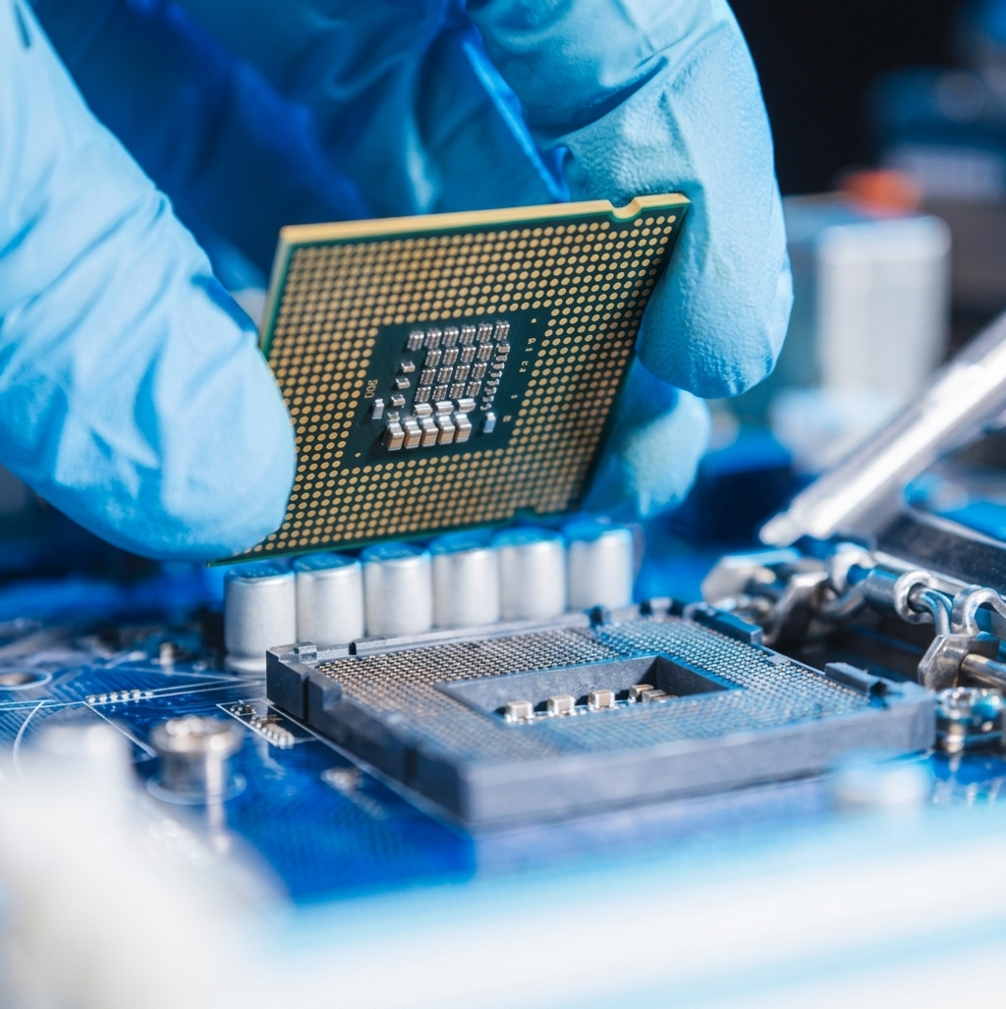
01
What Is a CPU?
Speaker 1
The “brain” that processes instructions and controls operations
Central Processing Unit
The CPU Processes Program Instructions And Helps Control The Operations Of A Computer.
Main Job
It Receives Instructions, Processes Data, Performs Operations, And Produces Results.
Where It Is
The CPU Is Installed On The Motherboard Inside The System Unit.
CPU = Processor
Modern CPUs can contain multiple processing cores for more efficient work.

Slide 4
02
How the CPU Fits into a Computer
Speaker 1
The CPU works together with memory, storage and input/output devices
Input
CPU
RAM / Memory
Output / Storage
Keyboard
Mouse
Process
instructions
Data and
instructions
Display
Storage
The CPU coordinates with RAM, storage and input/output devices to complete tasks.

Slide 5
03
Main Functions of the CPU
Speaker 2
Processing instructions and controlling computer operations
Process Instructions
Perform Operations
The CPU receives and processes instructions from computer programs.
It performs arithmetic, logical, comparison and data-movement operations.
It determines what operation needs to be performed.
Examples: calculate, compare values, move data, control tasks.
Controls
5 + 3 = 8

Slide 6
04
Fetch–Decode–Execute Cycle
Speaker 2
The basic process the CPU uses to carry out instructions
1. Fetch
2. Decode → 3. Execute
The CPU gets an instruction from memory.
Decode: the CPU interprets the instruction and identifies the required action.
The instruction tells the CPU what task needs to be performed.
Execute: the CPU performs the operation; the result may then be kept in a register or memory.
F
D
E
↻
Fetch → Decode → Execute → Repeat

Slide 7
05
Main Components of the CPU
Speaker 3
ALU, Control Unit, Registers and Cache work together
1
2
3
4
ALU
Control Unit
Registers
Cache
Arithmetic and logical
operations
Coordinates CPU
activities
Very fast temporary
storage
Keeps frequently used
data close to CPU
ALU + Control Unit + Registers + Cache → Efficient processing

Slide 8
06
How CPU Components Work Together
Speaker 3
Each internal component has a different role during processing
Control Unit
Registers and ALU
Directs and coordinates the activities of the CPU.
Registers hold current data; the ALU performs arithmetic, logic and comparisons.
Instruction
CU
Registers
ALU
Data
Register
ALU
Result
Register
Processing flow
Cache
Fast
Data
Access
Together
CU
ALU
Main idea: the Control Unit coordinates the work, registers hold current information, and the ALU performs the required operation.

Slide 9
07
What Affects CPU Performance?
Speaker 4
Several factors work together
Clock Speed
Number of Cores
Measured in GHz. Higher clock speed means more clock cycles per second.
More cores can handle more work at the same time.
Processor Architecture
Cache
CPU design and architecture affect how efficiently instructions are processed.
Frequently used data stays close to the CPU for faster access.
CPU performance depends on several factors working together — not only clock speed.

Slide 10
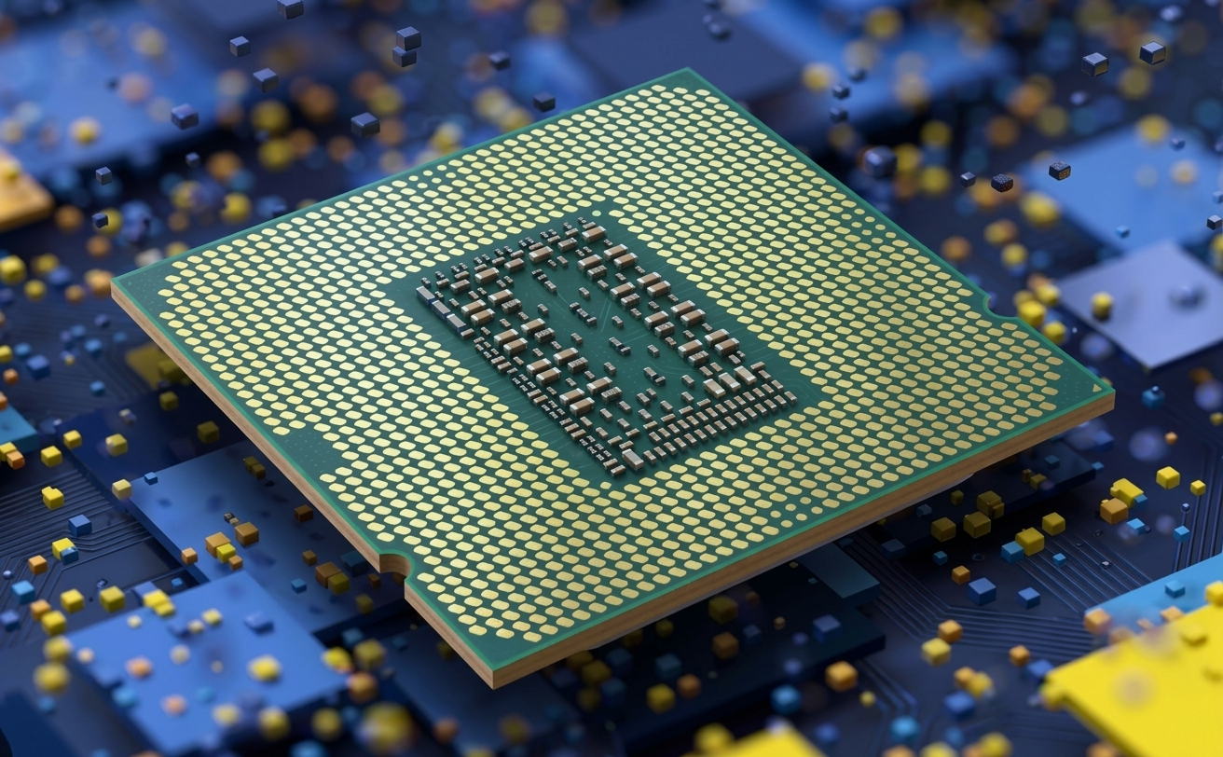
08
Multi-Core Processors
Speaker 4
One chip can contain two or more separate processor cores
More than one core
A multi-core processor has two or more separate processor cores on a single chip.
Parallel work
Different cores can work on different tasks or parts of a task at the same time.
Why it matters
Multiple cores can improve performance by sharing work instead of relying only on clock speed.
Examples: Dual-core • Quad-core • Octa-core

Slide 11
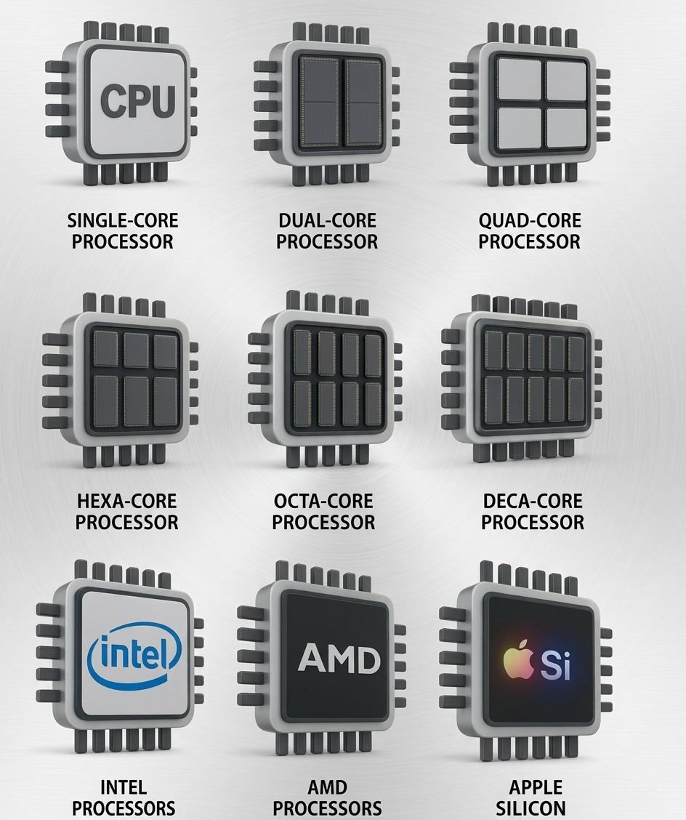
09
Types of CPUs
Speaker 5
Processors are designed for different devices and purposes
Desktop CPUs
1
Designed for personal computers with a strong focus on performance.
Laptop CPUs
2
Balance performance with battery life and lower power consumption.
Mobile / Server CPUs
3
Specialized processors are also used in phones, tablets, servers and embedded systems.
Different devices need different balances of performance, power use and efficiency.

Slide 12
10
Conclusion
Speaker 5
Five ideas to remember from our presentation
1
CPU
:Processes instructions and controls computer operations
2
Fetch–Decode–Execute
:The basic cycle used to carry out instructions
3
ALU + CU + Registers
:Core internal components with different roles
4
Performance
:Cores, clock speed, cache and architecture matter
5
CPU Types
:Desktop, laptop, mobile, server and embedded processors
Thank You

